Slide 1


ERAS4OLT.org

Slide 2
Enhanced Recovery After Liver Transplantation
Aim:
  Provide evidence-based recommendations on ERAS for deceased donor and living donor liver transplantation
Methods:
  Multi-disciplinary collaboration of experts worldwide
  Danish Model of Consensus
ERAS4OLT.org

Slide 3
Enhanced Recovery After Liver Transplantation
Chairs: Michael Spiro & Dimitri Raptis
Chief Investigators: Claus Niemann, Joerg-Matthias Pollok &
Marina Berenguer
ERAS4OLT.org

Slide 4






Partnership, Endorsements and Sponsors
IN PARTNERSHIP WITH
WORKING WITH
SPONSORS
ERAS4OLT.org

Slide 5
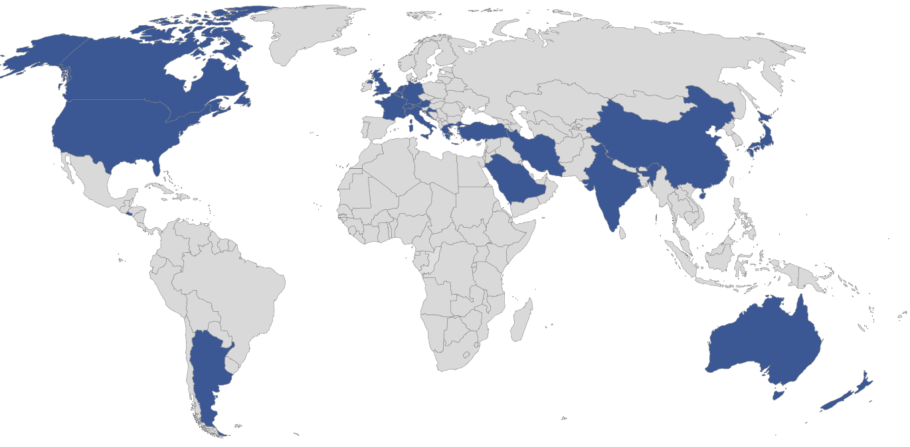
ERAS4OLT.org Members
ERAS4OLT.org

Slide 6
Enhanced Recovery after Surgery - ERAS
ERAS programmes reduce post-operative morbidity, hospital stay and costs without increasing readmission rates or mortality.
There are no standard, internationally accepted ERAS protocols designed for liver transplantation.
The domains of ERAS4OLT are not clearly defined.
ERAS4OLT.org

Slide 7
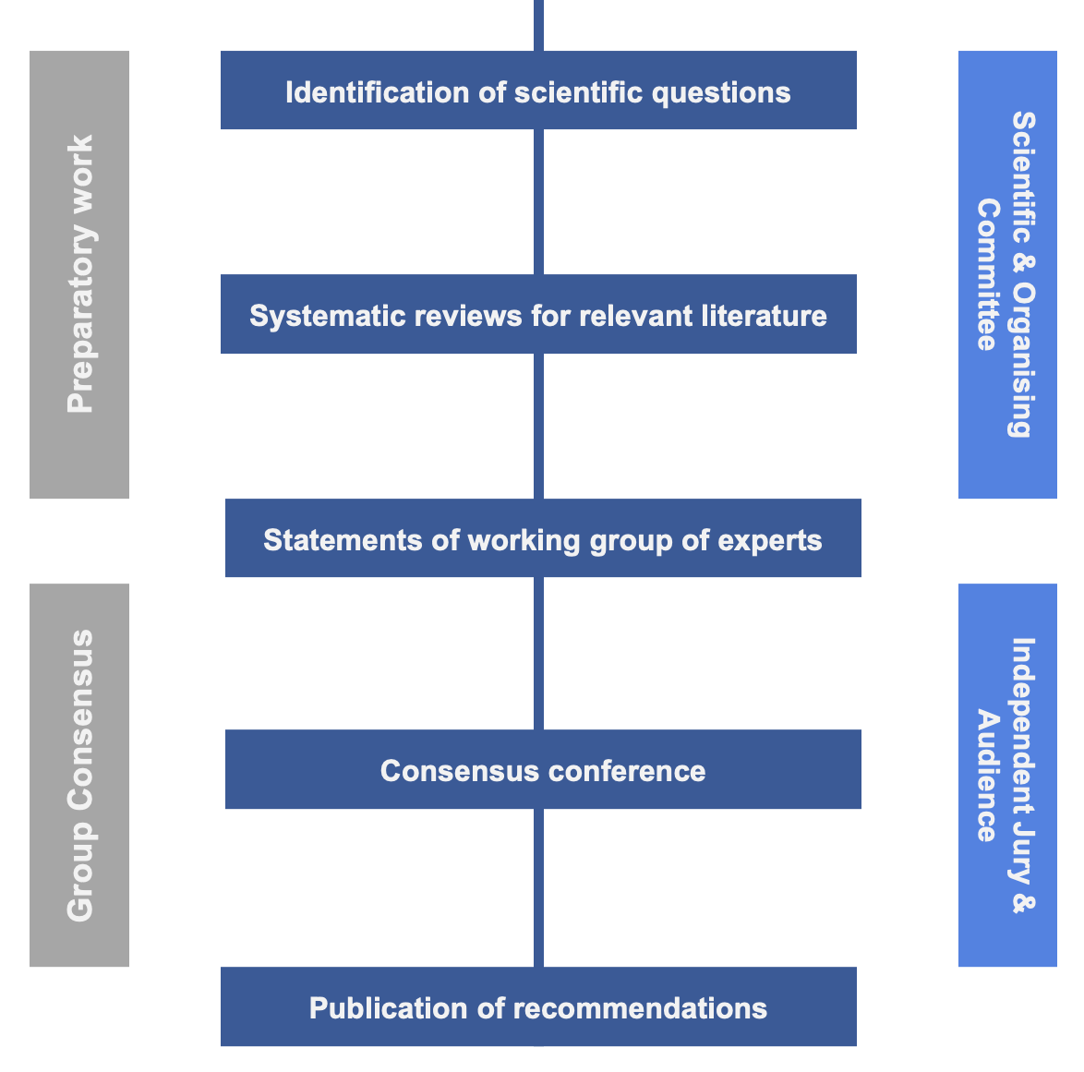
ERAS4OLT.org

Slide 8
Deceased Donor Liver Transplantation
Introduction
History
Lab values and biomarkers
Current evidence and domains of ERAS
Role of Complications
Preoperative measures
Preoperative assessment
Prehabilitation
Nutritional status
Councelling
ERAS4OLT.org

Slide 9
Deceased Donor Liver Transplantation
Intraoperative measures
Machine perfusion
Anaesthetic approach
Anaesthetic monitoring
Cava anastomotic technique
Surgical drains and T tubes
Intraoperative fluid management
Transfusion & products
Analgesia
Timing for extubation
ERAS4OLT.org

Slide 10
Deceased Donor Liver Transplantation
Postoperative measures
Thromboprophylaxis management
Antimicrobial prophylaxis
Drains and lines removal
Physiotherapy, occupational therapy and rehabilitation
Immunosuppression
Safest time for discharge
ERAS4OLT.org

Slide 11
Living Donor Liver Transplantation
Enhanced recovery of the living liver donor
Preoperative measures
Physiological workup
Surgical workup
Counselling
Intraoperative measures
Analgesia
Surgical technique
Postoperative measures
DVT prophylaxis
Safest time for discharge
ERAS4OLT.org

Slide 12
Living Donor Liver Transplantation
Enhanced recovery of the recipient after living liver donation
Preoperative measures
Graft to recipient weight ratio
Small-for-size syndrome
Patient selection / MELD
Intraoperative measures
Portal pressures and flows
ERAS4OLT.org

Slide 13
What is the GRADE approach
Grading of Recommendations, Assessment, Development and Evaluation
Transparent and structured system for developing, summarising and grading the quality of evidence for systematic reviews and recommendations in health care
GRADE working group: international team (>100) of guideline developers, methodologists, epidemiologists and clinicians worldwide
www.gradeworkinggroup.org
ERAS4OLT.org

Slide 14
Aim of GRADE approach
To describe the quality of evidence, i.e. confidence in effect estimates (how close are the reported estimates to the true values?), for each outcome separately
Taking into account
  The Risk of Bias for each study and across studies (similar to other approaches such Cochrane tool for RCTs or Robins tool for observational studies)
  Other factors essential in judging quality of a body of evidence, such as imprecision, inconsistency, indirectness
ERAS4OLT.org

Slide 15
Aim of GRADE approach
Provide comprehensive and transparent framework to develop recommendations based on the developed grading of evidence & estimates of values and resources
Helpful irrespective of quality of evidence (from very low to high)
Despite systematic approach to grading quality of evidence and strength of recommendations: inevitable need for judgements from systematic reviewers / guideline developers remains
ERAS4OLT.org

Slide 16
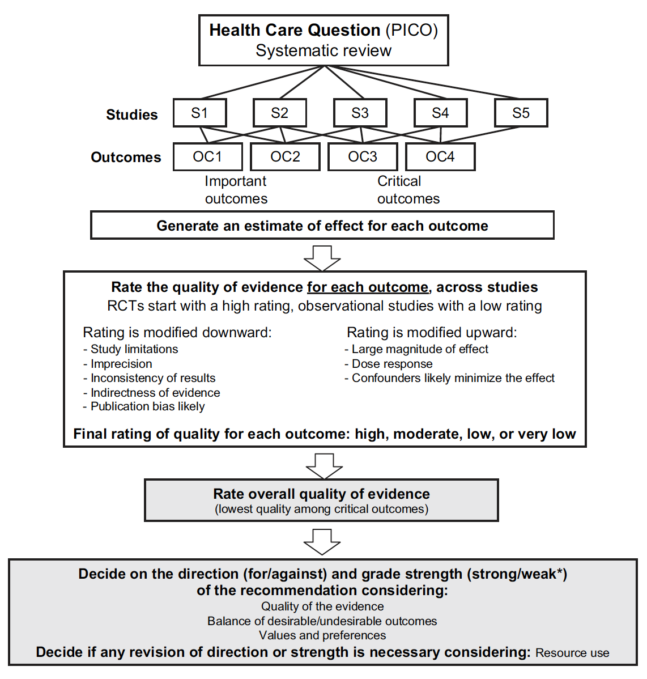
Schematic overview of GRADE approach
Step 1
Step 2
Step 3
ERAS4OLT.org
Ref 1 (see last slide)

Slide 17
Step 1: Systematic review
Define critical outcomes
Generate estimates of effect for each outcome
  (If feasible: calculate pooled summary estimates (Meta-analysis))
  If not feasible (ERAS4OLT reviews): narrative summary
  see example in this presentation
ERAS4OLT.org

Slide 18
Step 2: Rate Quality of Evidence
Make judgements for each GRADE domain, for each outcome across studies
  Limitations (Risk of Bias)
  Indirectness
  Imprecision
  Inconsistency
  Publication bias
ERAS4OLT.org

Slide 19
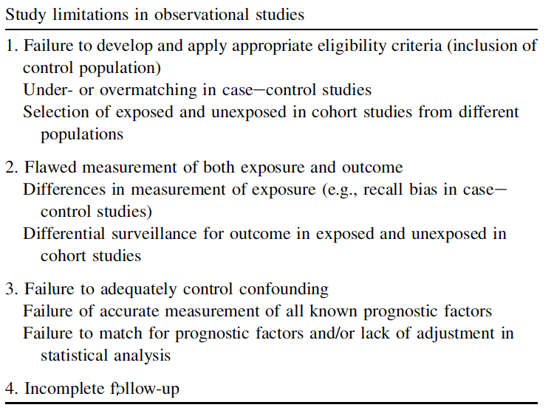
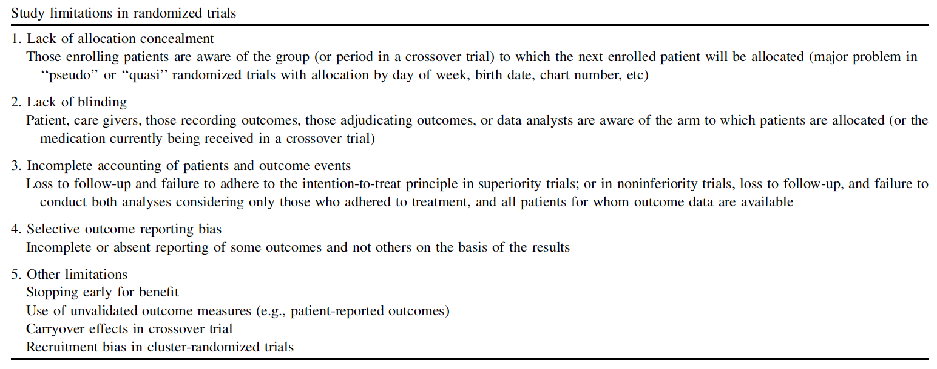
Step 2A: Limitations (Risk of Bias):
ERAS4OLT.org
Ref 5 (see last slide)

Slide 20
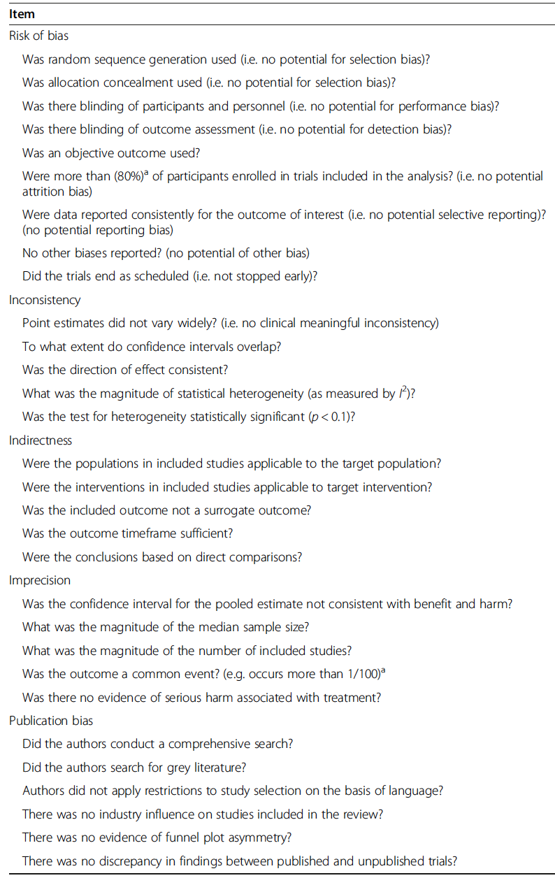
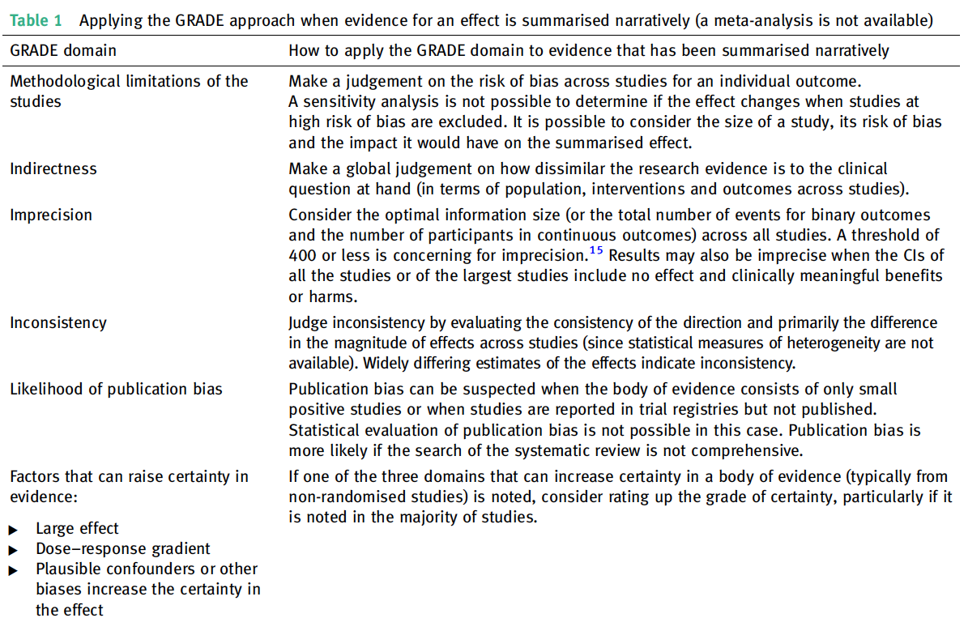
Step 2A
ERAS4OLT.org
Ref 2 and 3 (see last slide)

Slide 21
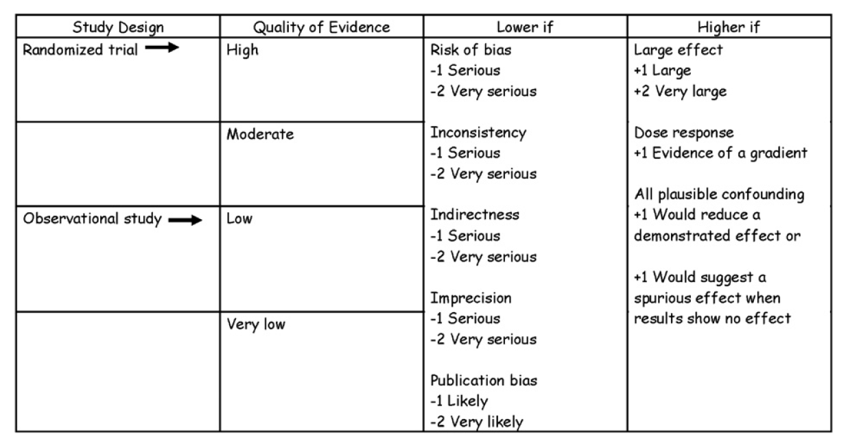
Step 2: Rate Quality of Evidence
Generate Summary of Findings table using template
Rate Quality of Evidence for each outcome across studies, based on Summary of Findings table
  RCT start with high quality of evidence
  Observational studies start with low quality of evidence
Include Quality of Evidence into Summary of Findings table
see example in this presentation
ERAS4OLT.org
Ref 1 (see last slide)

Slide 22
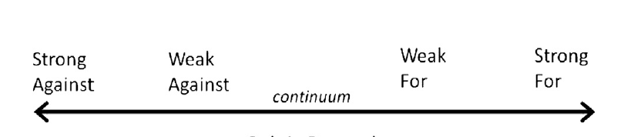
Step 3: Recommendations grading
Generate Evidence to Recommendation framework table, using template
Decide on direction and strength of recommendation based on Evidence to Recommendation framework table
see example in this presentation
ERAS4OLT.org
Ref 6 (see last slide)

Slide 23
Example GRADE approach without meta-analysis
Question: How do Enhanced Recovery After Surgery protocols affect short-term outcomes in Liver Transplantation?
GRADE approach
  Step 1: Systematic review
  Step 2: Rate Quality of Evidence
  Step 3: Recommendations grading
ERAS4OLT.org
Ref 2 (see last slide)

Slide 24
Step 1: Systematic review: Summarize estimates of effect for each outcome
Defined outcomes: | ICU length of stay (days) | Overall complications | Overall mortality | Hospital length of stay (days) | Hospital readmission
Brustia, 2018 | 3 (3, 4) | 5/10 (50%) | 0/10 | 9.5 (9, 10.5) | 3/10 (30%)
Findlay, 2002 | 1.1 (0.5, 3) * | - | - | - | -
King, 2018 | 2.6 (1.6, 4.1) | - | 1/141 (1%) | 5.6 (4.5, 7.5) | -
Rao, 2017 | 2 (1, 7) | 10/54 (18.5%) | 0/54 | 18 (15, 32) | 0/54
Xu, 2020 | 2 (2, 3) | 9/40 (22.5%) | 2/40 (5.0%) | 14.5 (12, 17) | 0/40
ERAS4OLT.org
Ref 2 (see last slide)

Slide 25
Step 2A: Make judgements for GRADE domains, for each outcome across studies
Example outcome: Overall complications
GRADE domain | Reasoning for judgement | Judgement
Limitations | In the observational studies, exposure/outcome measures were adequate and follow-up complete. Eligibility criteria and confounding control was mostly adequate. In the RCT, even though the type of randomization remained unclear, there was no loss to follow-up or selective outcome reporting .The risk of bias across studies was considered low. | Not serious
Inconsistency | Even though slightly varying, the direction of point estimates was consistent | Not serious
Indirectness | The included study population and interventions were consistent with the target population and target intervention (applied PICO criteria yielded results of interest). Conclusions were based on direct comparisons. | Not serious
Imprecision | The magnitude of the overall sample size was low (<400 number of events), and the imprecision therefore judged serious. | Serious
Publication bias | A comprehensive systematic review was performed | Not likely
ERAS4OLT.org
Ref 2 (see last slide)

Slide 26
Step 2B: Generate Summary of Findings table, according to template
Summary of Findings
Number Studies |  | N Participants |  | Effect from comparative studies | Limitations | Inconsistency | Indirectness | Imprecision | Publication Bias
RCT | Observational | ERAS | Control
Outcome: Overall Complications (%)
1 | 2 | 104 | 147 | Clearly lower in ERAS in all studies | Not serious | Not serious | Not serious | Serious ^{B} | Not llikely
Outcome: Mortality (%)
1 | 3 | 245 | 253 | Lower in ERAS in all studies, few events | Not serious | Not serious | Not serious | Serious ^{A} | Not llikely
Outcome: Length of Intensive Care Unit Stay (days)
2 | 3 | 284 | 292 | Lower in ERAS in all studies | Not serious | Not serious | Not serious | Not serious | Not llikely
Outcome: Length of Hospital Stay
1 | 3 | 245 | 253 | Lower in ERAS in all studies | Not serious | Not serious | Not serious | Not serious | Not likely
Outcome: Hospital Readmission
1 | 2 | 104 | 147 | Similar, very few events | Not serious | Not serious | Not serious | Serious ^{A,B} | Not likely
^{A} Rated serious due to large CI involving 1 of pooled estimates
^{B} Rated serious due to overall sample size (<400 number of events)
^{← Giving reason for judgements}
ERAS4OLT.org
ERAS4OLT.org
Ref 1, 2 and 4 (see last slide)

Slide 27
Step 2C: Rate Quality of Evidence for each outcome across studies
Example outcome: Overall complications
Number Studies |  | N Participants |  | Effect from comparative studies | Limitations (Risk of Bias) | Inconsistency | Indirectness | Imprecision | Publication Bias
RCT | Observational | ERAS | Control
1 | 2 | 104 | 147 | Clearly lower in ERAS in all studies | Not serious | Not serious | Not serious | Serious | Not likely
1 RCT (starting at High):
  Downgraded due to serious imprecision
  Upgrading due to effect size
2 Observational studies (starting at Low)
  Downgraded due to serious imprecision
  Upgrading due to effect size
High
Moderate
Low
ERAS4OLT.org
Ref 1, 2 and 4 (see last slide)

Slide 28
Step 2D: Include Quality of Evidence into Summary of Findings table
Summary of Findings
Number Studies |  | N Participants |  | Effect from comparative studies | Limitations | Inconsistency | Inconsistency | Indirectness | Imprecision | Publication Bias | Quality of Evidence (GRADE)
RCT | Observational | ERAS | Control
Outcome: Overall Complications (%)
1 | 2 | 104 | 147 | Lower in ERAS in all studies | Not serious | Not serious |  | Not serious | Serious ^{B} | Not likely | Moderate ^{a,b} ●●●○
Outcome: Mortality (%)
1 | 3 | 245 | 253 | Lower in ERAS in all studies, few events | Not serious | Not serious |  | Not serious | Serious ^{A} | Not likely | Low ª ●●○○
Outcome: Length of Intensive Care Unit Stay (days)
2 | 3 | 284 | 292 | Lower in ERAS in all studies | Not serious | Not serious |  | Not serious | Not serious | Not likely | Moderate ●●●○
Outcome: Length of Hospital Stay
1 | 3 | 245 | 253 | Lower in ERAS in all studies | Not serious | Not serious |  | Not serious | Not serious | Not likely | Moderate ●●●○
Outcome: Hospital Readmission
1 | 2 | 104 | 147 | Similar, very few events | Not serious | Not serious |  | Not serious | Serious ^{A,B} | Not likely | Low ª ●●○○
ª Downgrading due to serious imprecision
^{b} Upgrading due to magnitude of effect size
^{← Giving reason for judgements}
ERAS4OLT.org
Ref 1, 2 and 4 (see last slide)

Slide 29
Step 3: Recommendation grading, according to template
Question: How do Enhanced Recovery After Surgery protocols affect short-term outcomes in Liver Transplantation?
Decision domain | Judgement |  | Reason for Judgement | Subdomains influencing Judgement (Andrews et al., 2013)
 | Yes | No
Balance between desirable and undesirable outcomes (estimated effects), with consideration of values and preferences (estimated typical) Given the best estimate of typical values and preferences, are you confident that the benefits outweigh the harms and burden or vice versa? | ✓ |  | The desirable consequences are substantial (including significant reduction of overall complications, ICU and hospital length of stay), and valued highly. The undesirable consequences, inconvenience and burden for patients (including potentially higher efforts for patients and institutions when implementing ERAS protocols) are relatively minor when compared to the desirable consequences (morbidity) | Baseline risk for desirable and undesirable outcomes: Is baseline risk similar across subgroups? Should there be separate recommendations for subgroups? Relative risk for benefits and harms: Are relative benefits / harms large? Requirement for modeling: Is there a lot of extrapolation and modeling required for outcomes? Typical values: What are the typical values? Differences in the relative value of critical outcomes?
Confidence in the magnitude of estimates of effect of the interventions on important outcomes (overall quality of evidence for outcomes) Is there high or moderate quality evidence? |  | ✓ | Reduced overall complications, ICU and hospital length of stay with ERAS: moderate ●●●○ Reduced mortality in ERAS: low ●●○○ Increased hospital readmission rate in ERAS: low ●●○○ | Confidence in estimates of benefits and downsides, confidence in estimates of resource use. Consider all critical outcomes, including the possibility that some may not be measured. Key reasons for rating evidence down or rating up
Confidence in Values and Preference, and their Variability Are you confident about the typical values and preferences and are they similar across the target population? | ✓ |  | We can be confident that patients with ESLD listed or undergoing LT place a high value on avoiding complications and mortality. The inconvenience of potentially higher efforts for patients and institutions when implementing ERAS protocols is generally considered lower than the value on avoiding complications. These estimations are based on the clinical experience of all authors, derived from varying clinical, ethnical, age and gender backgrounds. | Source of typical values (panel or study of general population or patients). Source of estimates of variability and extent of variability. Method for determining values satisfactory for this recommendation.
Resource implications Are the resources worth the expected net benefit from following the recommendation? | ✓ |  | The resources required to establish comprehensive ERAS protocols are rated lower than the probable net reduction in costs resulting from decreased ICU and hospital length of stay, as described in 1 included paper (King et al., 2018) and known from ERAS programs in other surgical settings, and given the desirable outcomes | What are the costs per resource unit? Feasibility: Is this intervention generally available? Opportunity cost: Is this intervention and its effects worth withdrawing or not allocating resources from other interventions? Differences across settings: Is there lots of variability in resource requirements across settings?
Overall Strength of Recommendation | Strong For |  | Considering all decision domains, the guideline panel recommends that comprehensive and standardized ERAS for LT programs should be developed and implemented.
Evidence to Recommendation Synthesis | The i) high confidence in the mainly moderate magnitude of effect on highly valued outcomes, ii) moderate confidence that undesirable outcomes are present, and iii) high confidence in benefits regarding resource implications, suggest a strong recommendation
ERAS4OLT.org
Ref 6 and 7 (see last slide)

Slide 30
More information..
https://gdt.gradepro.org/app/handbook/handbook.html
https://training.cochrane.org/grade-approach
ERAS4OLT.org
Ref 1, 2 and 4 (see last slide)

Slide 31
Timeline ERAS4OLT
ERAS4OLT.org

Slide 32

ILTS Consensus Conference
Date
January 28-29, 2022
Venue
Sercotel Sorolla Palace
Av. de las Cortes Valencianas
5846015 Valencia, Spain
https://ilts.org/events/2022-ilts-consensus-conference/
ERAS4OLT.org

Slide 33
References
Guyatt G, Oxman AD, Akl EA, et al. GRADE guidelines: 1. Introduction—GRADE evidence profiles and summary of findings tables. J Clin Epidemiol. 2011;64(4):383-394. doi:10.1016/j.jclinepi.2010.04.026
Murad MH, Mustafa RA, Schünemann HJ, Sultan S, Santesso N. Rating the certainty in evidence in the absence of a single estimate of effect. Evid Based Med. 2017;22(3):85-87. doi:10.1136/ebmed-2017-110668
Meader N, King K, Llewellyn A, et al. A checklist designed to aid consistency and reproducibility of GRADE assessments: development and pilot validation. Syst Rev. 2014;3:82. doi:10.1186/2046-4053-3-82
Balshem H, Helfand M, Schünemann HJ, et al. GRADE guidelines: 3. Rating the quality of evidence. J Clin Epidemiol. 2011;64(4):401-406. doi:10.1016/j.jclinepi.2010.07.015
Guyatt GH, Oxman AD, Vist G, et al. GRADE guidelines: 4. Rating the quality of evidence--study limitations (risk of bias). J Clin Epidemiol. 2011;64(4):407-415. doi:10.1016/j.jclinepi.2010.07.017
Andrews J, Guyatt G, Oxman AD, et al. GRADE guidelines: 14. Going from evidence to recommendations: the significance and presentation of recommendations. J Clin Epidemiol. 2013;66(7):719-725. doi:10.1016/j.jclinepi.2012.03.013
Andrews JC, Schünemann HJ, Oxman AD, et al. GRADE guidelines: 15. Going from evidence to recommendation—determinants of a recommendation’s direction and strength. J Clin Epidemiol. 2013;66(7):726-735. doi:10.1016/j.jclinepi.2013.02.003
ERAS4OLT.org

Slide 34
THANK YOU !
ERAS4OLT.org

